Slide 1
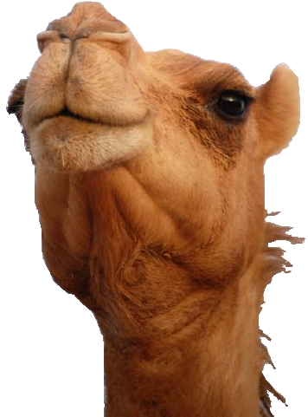
An Introduction to Perl
By
Mahesh Subbiah

Slide 2
Agenda
What is Perl?
Comments in Perl
Scalar Variables in Perl
Arithmetic Operations in Perl
User inputs in Perl
Shell command in Perl
Branching statements: if, unless, backward if
Comparison and Logical operators
Command Grouping
String operators
Automatic conversion Number ←→ String
Perl's built-in warnings
Looping constructs: while, until, do...while, for, foreach
Keywords supported by loops: last, next, redo,
Labelling the loops
The "undef" value and defined function

Slide 3
Agenda
Reading from a file
HASH
Lists and Arrays
Pop and push operators
Shift and unshift operators
Perl's favorite default: $_
The reverse operator
The sort operator
Scalar and list context
The split function
Pattern Matching
Replace and translate operators
Pattern memory
References
Subroutines
Command line arguments in Perl
Variable Scoping
Files and Directories

Slide 4
What is Perl?
Perl, Practical Extraction and Reporting Language, is an interpreted programming language developed by Larry Wall in 1987.
Perl is installed by default in any Unix flavored OS.
Perl needs to be installed in windows system by downloading from the link: www.activestate.com/activeperl/download.htm

Slide 5
What is Perl?
To get to know the perl version available in the Unix / Windows system, type this command in the command prompt.
perl -v
To get the perl help from Unix as well as windows system,
perldoc -f <function name> → to get the help for a function
perldoc -m <module name> → to get the help for a module
Examples:
perldoc -f split perldoc -m socket perldoc -m dbi
perldoc -m file perldoc -m switch

Slide 6
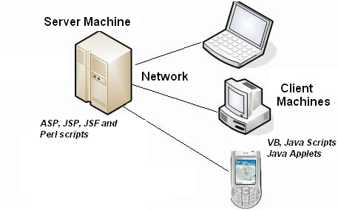
Perl is a server side scripting language

Slide 7
Where the Perl is installed?
In Unix machines, the command "whereis perl" displays the path where the perl program is available.
$ whereis perl
perl: /usr/bin/perl /usr/share/man/man1/perl.1.gz
In Windows machines, the default path is: c:\Perl\bin\perl.exe

Slide 8
“Hello World” program in Perl
In Unix machines,
#!/usr/bin/perl
print "Hello\n";
print "world\n";
In Windows machines,
#!d:\Perl\bin\perl
print "Hello\n"
print "world\n"
The first line in the script is called "shabang" statement. It tells the operating system that the file is to be executed by the Perl interpreter.
Every line in a perl program (except "shabang" and comment statements) should end with a semicolon(;).

Slide 9
Is the "shabang" statement compulsory?
There are two ways to execute a perl script: If the perl program is stored in the file sample.pl,
Method 1: perl sample.pl
Method 2: ./sample.pl
If you execute the script by the first method, the "shabang" statement is not required.
If you execute the script by the second method, the "shabang" statement is mandatory.

Slide 10
Is the "shabang" statement compulsory?
The execute permission is required in Unix system if you execute the Perl program by the method 2.
Irrespective of whether the "shabang" statement is required or not, it is a good practice to have the "shabang" as the first line in every Perl program.
The “shabang” statement should start at the column 1 in line 1 or otherwise it doesn't have any significance.

Slide 11
Comments in Perl program
Comment lines should start with #
Multiple line comments should be inside the pair of "=cut;".
=cut;
comment line 1
comment line 2
...
=cut;
Example:
#this is a one line comment
=cut;
This is a
multi line
comments
in Perl.
=cut;

Slide 12
Scalar Variables in Perl
Scalar variable in Perl can hold an integer, a string or a float value.
$var1 = 34.5678;
$var2 = 25;
$var3 = “string“;
Scalar variables in Perl are always referenced with the leading $. In the shell, you use $ to get the value, but leave the $ off to assign a new value. In C, you leave $ off entirely.
Memory allocator for a variable is dynamic. The memory is being allocated in heap.

Slide 13

Arithmetic operations in Perl
(This is not the complete list)
$a = 25;
$a += 5;
$a *= 3;
$a++;
--$a;
$a /= 7;
$a %= 3;
$a = $b + $c;
$a = $b - $c;
$a = $b * $c;
$a = $b / $c;
$a = $b % $c;
$a = $b ** $c;
# a = b to the power c

Slide 14
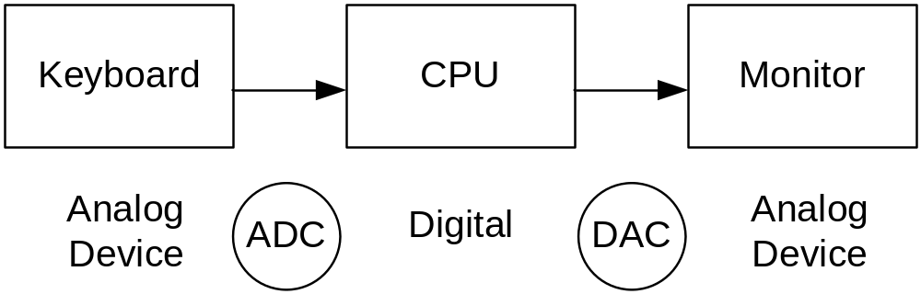
User inputs in Perl program
Keyboard is a slow device. It operates in 50/60 Hz.
CPU operates in MHz.
Monitor is again a slow device.
To synchronize this communication, we use stream communication: stdin and stdout.

Slide 15

User inputs in Perl program
To get an user input from keyboard, $var = <STDIN>; This accepts the user input, until user presses "Enter" key (newline character). Perl stores the newline character also at the end of the user input.
chomp is the function to remove the trailing newline character.
$fname = <STDIN>;
chomp($fname); # The parentheses are optional.
The above two statements shall be combined as a single statement as below.
chomp($fname=<STDIN>);
To display a result on the monitor,
print "The value of the var= $var \n"; The "print" command doesn't display newline character until otherwise specified.

Slide 16
Shell command in Perl program
We can store the output of any shell command or OS command in a Perl variable.
$var = `dir`;
The command must be mentioned within back quotes (``).
This method of executing a shell (or OS) command inside a Perl program makes the Perl program non-portable.
The 'system' command can also be used for executing a shell (or OS) command. In this case, the user doesn’t have the control over the output.
#!C:\Perl\bin\Perl
# Difference between ` and
# system command.
# We get the control over the
# output
$var = `dir`;
print "list: $var\n";
# Do not have the control over the
# output
system("dir");

Slide 17
Branching statements
if (expression)
{
true block;
}
else
{
false block;
}
if (expression)
{
true block1;
}
elsif (expression)
{
true block2;
}
else
{
false block;
}
The curly braces ({ }) are mandatory irrespective whether single or multiple statements inside a true / false blocks.

Slide 18
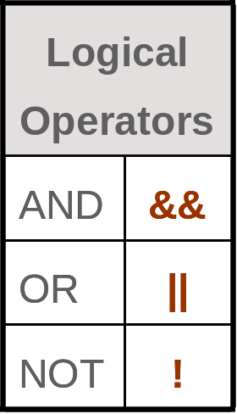
Comparison and Logical Operators
Operation | Numerical Comparison | String Comparison
Equal to | == | eq
Not equal to | != | ne
Greater than | > | gt
Greater than or equal to | >= | ge
Less than | < | lt
Less than or equal to | <= | le

Slide 19

Exercise: 1
Write a Perl program to find the maximum among three numbers

Slide 20
Branching statements
Backward “if” statement: If there is only one statement to be executed if a condition is true,
  print "Hello" if ($a == 10);
  $count++ if ($var eq "pattern”);
Negation of “if”:
  unless (expression)
  {
  true block;
  }
  else
  {
  false block;
  }

Slide 21
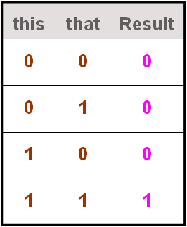
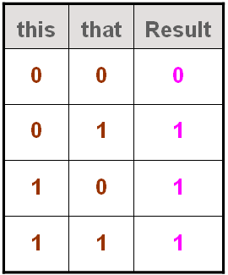
Command Grouping
this && that;
  “if this then that”
  “if not this then not that”
Example: $a == 10 && print "Hello";
this || that;
  “if this then not that”
  “if not this then that”
Example: $a ne "Hello" || print "Match";

Slide 22
String Operators
String concatenation operator: String values can be concatenated with the . operator. The resulting string is then available for further computation or to be stored into a variable. For example,
  'hello" . 'world' # same as "helloworld"
  'hello' . ' ' . 'world' # same as "hello world"
  'hello world' . "\n" # same as "hello world\n"
Note that, the concatenation must be explicitly requested with the . operator, unlike in some other languages, where you need to have two strings next to each other for concatenation.

Slide 23
String Operators
String repetition operator: A special string operator is the string repetition operator, consisting of the single lowercase letter x. This operator takes its left operand and makes as many concatenated copies of that string as indicated by its right operand. For example,
  "fred" x 3 # is "fredfredfred"
  "barney" x (4+1) # is "barneybarneybarneybarneybarney"
  5 x 4 # is "5" x 4, which is "5555"

Slide 24
Automatic conversion: Number ↔ String
Perl automatically converts between numbers to strings as needed.
How does Perl know whether a number or a string is needed? It all depends upon the operator being used on the scalar value.
  When a string value is used where an operator needs a number, Perl automatically converts the string to its equivalent numeric value. Trailing non-number stuff and leading whitespace are discarded if a string value is used where number is expected. So "12fred34" * 3 gives the value of "36".
  when a numeric value is used where an operator needs a string, Perl automatically converts the number to its equivalent string value.
  "z" . 5 * 7 # is "z" . 35, which is "z" . "35" or "z35"

Slide 25
Perl's build-in warnings
You can tell Perl to warn you when it sees something suspicious going on in your program. To run a perl program with warnings,
  $perl -w sample.pl
If you always want warnings, the "shabang" statement shall be modified as below:
  #!/usr/bin/perl -w
Now, perl will warn you if you use "12fred34" as if it were a number.
  Argument "12fred34" isn't numeric
Note: Warnings doesn't stop the program

Slide 26
Looping constructs: “while”
while (condition)
{
statements;
}
The loop is executed iteratively if the condition is true. Control comes out of the loop when the condition becomes false.
Example:
$i = 1;
while ($i <= 10)
{
print "$i\n";
$i += 2;
}

Slide 27
Looping constructs: “until”
until (condition)
{
statements;
}
The loop is executed iteratively if the condition is false. Control comes out of the loop when the condition becomes true.
Example:
until ($j > $i)
{
$j *= 2;
}

Slide 28
Looping constructs: “do…while”
do
{
statements;
}while(condition);
Same as the while loop except, the condition is not verified for the first time.
Example:
do
{
print “cont y or n”;
chomp($ans=<STDIN>);
}while($ans eq “y” || $ans eq “Y”);

Slide 29
Looping constructs: “for”
for(initialization; condition; interval)
{
statements;
}
Example:
for($i = -150; $i <= 1000; $i+=3)
{
print “$i\n”;
}

Slide 30
Looping constructs: “foreach”
foreach $var (list)
{
statements;
}
The foreach loop steps through a list of values, executing one iteration for each value.
Example:
foreach $i (10, hello, 20, world, 30.25)
{
print “$i\n”
}

Slide 31
Keywords supported by loops: “last”
Same as "break" statement in C.
This keyword is used to terminate a loop
Example:
  for($i=1; $i <= 10; $i++)
  {
  if ( $i == 5)
  {
  last;
  }
  print "$i ";
  }
  → This piece of code produces the output: 1 2 3 4

Slide 32
Keywords supported by loops: “next”
Same as "continue" statement in C.
This keyword is used to skip some statements in a iterative loop
Example:
  for($i=1; $i <= 10; $i++)
  {
  if ( $i == 5)
  {
  next;
  }
  print "$i ";
  }
  → This piece of code produces the output: 1 2 3 4 6 7 8 9 10

Slide 33
Keywords supported by loops: “redo”
The difference between the "next" operator and "redo" operator is that "next" will advance to the next iteration, but "redo" will redo the current iteration.
Example:
  foreach (1..10) {
  print "The interation number: $_\n\n";
  print "Please choose: last, next, redo, or none of the above? ";
  chomp(my $choice = <STDIN>);
  print "\n";
  last if $choice =~ /last/i;
  next if $choice =~ /next/i;
  redo if $choice =~ /redo/i;
  print "That's none of the above\n\n";
  }

Slide 34
Labeling the loops
We can label the loops as convenient.
Example:
OUTER: for ($i = 1; $i < 5; $i++)
{
INNER: for ($j =1; $j < 5; $j++)
{
print "$i $j";
last OUTER;
}
}
→ This piece of code produces the output: 1 1

Slide 35
The “undef” value
The default value for any variable is "undef". It is 0 if the variable is number. It is an empty string if the variable is a string.
Example:
#!/usr/bin/perl -w
$n = 1;
while ($n < 10)
{
$sum += $n; # very first time, $sum = undef + $n,
# which is $sum = 0 + $n or $sum = $n
$n += 2;
}
$string .= "more text“; # $string = undef . "more text" or
# $string = "" . "more text"

Slide 36
The “defined” function
#!/usr/bin/perl
chomp($modanna = <STDIN>);
if ( defined($modanna) ) # returns true if the variable "modanna"
# doesnt have undef
{
print "The input was $modanna";
}
else
{
print "No input available";
}

Slide 37
Lists and Arrays
A list is a collection of scalars. An array is a variable that contains a list.
The elements of an array are indexed with the starting value zero.
Each element in an array or list is an independent scalar value and hence they may hold numbers, strings, undef values, or any mixture of different scalar values.
Example:
$fred[0] = "yabba"; $fred[1] = 123.45; $fred[2] = 1000;
The array name is from a completely separate namespace than scalars use; you could have a scalar variable named $fred and an array variable @fred in the same program.
Array element can be accessed like $fred[2] in every place where you could use any other scalar variable. But, if you wish to access the entire array, the at-sign (@) before the name is used, @fred.

Slide 38
Special array indices
If you store into an array element that is beyond the end of the array, the array is automatically extended as needed. Intervening elements will be created with "undef" values.
Example: $rocks[0] = 'bedrock'; $rocks[1] = 'lava';
$rocks[2] = 'crushed rock'; $rocks[99] = 'schist';
Now there are 95 "undef" elements.
The last element of the array can be indexed by $#rocks (i.e.) $rocks[$#rocks] gives the scalar value 'schist'. Hence the size of an array can be obtained by "$#rocks + 1".
Another way of accessing last element in an array: If you've got three elements in the array, the valid negative indices are -1 (the last element), -2 (the middle element) and -3 (the first element). In the previous example, $rocks[-1] is equivalent to $rocks[99]
$rocks[-100] is equivalent to $rocks[0].

Slide 39
List literals
A list literal is a list of comma-separated values enclosed in parenthesis.
Examples:
(1, 2, 3)
(1, 2, 3,) # the trailing comma is ignored
("fred", 4.5)
() # empty list
(1..100) # list of 100 elements
The list elements not necessarily constants. They can also be expressions:
Examples:
($a, 17)
($b+$c, $d+$e)
("fred", "barney", "betty", "wilma", $d)

Slide 40
List literals
The last example uses the range operator "..", which creates a list of values by counting from the left scalar up to the right scalar by ones.
Examples:
(1..5) # same as (1, 2, 3, 4, 5)
(1.7..5.7) # same as (1, 2, 3, 4, 5) - both values # are truncated to the smallest whole number
(5..1) # empty list - ".." counts only upwards
(0, 2..6, 10, 12) # same as (0, 2, 3, 4, 5, 6, 10, 12)
($a..$b) # range determined by current values of # $a and $b
(0..$#rocks) # same as (0, 1, 2, 3, .., 99)
# where $#rocks = 99

Slide 41
The “qw” shortcut (qw → quoted words)
A list of simple words like ("fred", "barney", "betty", "wilma", "dino") are frequently used in Perl programs.
The qw shortcut makes it easy to generate them without typing a lot of quotation marks: qw/ fred barney betty wilma dino /
Perl treats it like a single quoted string, so you cant use \n or $fred inside a qw list.
The whitespaces will be discarded and whatever left becomes the list of items. Hence there's another way of writing the same list:
qw/ fred
barney
wilma dino/

Slide 42
The “qw” shortcut (qw → quoted words)
Perl allows any punctuation character as delimiter. Some of the common ones:
  qw! fred barney betty wilma dino !
  qw# fred barney betty wilma dino #
  qw( fred barney betty wilma dino )
  qw{ fred barney betty wilma dino }
  qw[ fred barney betty wilma dino ]
  qw< fred barney betty wilma dino >
One good example, if you need to store the list of filenames:
  qw{
  /usr/dict/words
  /home/susan/.bash_profile
  }

Slide 43
List Assignment
List values may also be assigned to variables:
($fred, $barney, $dino) = ("flinstone", "rubble", undef);
For swapping two variables, It's easy to swap two variables in Perl
($fred, $barney) = ($barney, $fred);
($betty[0], $betty[1]) = ($betty[1], $betty[0]);
Extra list elements are ignored
($fred, $barney) = qw< flinstone rubble slate granite >; # two ignored items
if the list is not adequate, undef is assigned.
($wilma, $dino) = qw[flinstone]; # $dino gets undef

Slide 44
List Assignment
When you wish to assign values for an entire array,
($fred[0], $fred[1], $fred[2], $fred[3]) = qw/ talc mica feldspar quartz /;
can be written as, @fred = qw/ talc mica feldspar quartz/
Some more examples:
  @rocks = qw(bedrock slate lava);
  @tiny = (); # empty list
  @giant = 1..1e5; # a list with 100,000 elements
  @stuff = (@giant, undef, @giant) # a list with 200,001 elements
To copy an array into another array,
  @copy = @rocks;

Slide 45
The pop and push Operator
One common use of an array is as a stack of information, where new values are added to and removed from the right hand-side of the list.
Examples for pop operations
@array = 5..9;
$fred = pop(@array); # $fred gets 9, @array now has (5, 6, 7, 8)
$barney = pop @array; # $barney gets 8, @array now has (5, 6, 7)
pop @array; # @array now has (5, 6), The 7 is discarded
pop @array; pop @array; # @array now is empty
pop @array; # returns undef
Examples for push operations:
@array = (5, 6);
push(@array, 0);# @array now has (5, 6, 0)
push @array, 8; # @array now has (5, 6, 0, 8)
push @array, 1..10; # @array now has (5, 6, 0, 8, 1, 2, 3..10)
@others = qw/ 9 0 2 1 0/;
push @array, @others; # @array now has (5, 6, 0, 8, 1, 2, 3..10, 9, 0, 2, 1, 0)

Slide 46
The shift and unshift Operators
Push and pop operations do things at the end of an array. Similarly, the unshift and shift operators perform the corresponding actions on the "start" of the array.
Examples for shift operations
@array = qw(dino fred barney);
$a = shift(@array); # $a gets "dino", @array now has ("fred", "barney");
$b = shift @array; # $b gets "fred", @array now has ("barney");
shift @array; # @array now empty
$c = shift @array; # $c gets undef, @array is still empty
Examples for unshift operations:
unshift(@array, 5); # @array now has (5)
unshift @array, 4; # @array now has (4, 5)
@others = 1..3;
unshift @array @others; # @array now has (1, 2, 3, 4, 5)

Slide 47
foreach - Control structure
To process an entire array or list, Perl provides a control structure foreach. The foreach loop steps through a list of values, executing one iteration for each value:
foreach $rock (qw/ bedrock slate lava /)
{
print "One rock is $rock.\n";
}
$var = 500;
foreach $var (qw/ bedrock slate lava/)
{
$var = 750;
}
print "The value of var= $var";
The last print statement displays: "The value of var= 500". That means that if you want to name your loop control variable $var, you dont have to worry that maybe you've already used that name for another variable.

Slide 48
Perl's favorite Default: $_
If you omit the control variable from the foreach loop, Perl uses its favorite default variable $_.
  foreach (1..10)
  {
  print "The current value: $_";
  }
"print" command takes the default argument $_ if no other argument is given.
  $_ = "Yabba dabba doo\n";
  print; # prints $_ by default

Slide 49
The “reverse” operator
The reverse operator takes a list of values and returns the list in the opposite order.
  @fred = 6..10;
  @barney = reverse(@fred); # gets 10, 9, 8, 7, 6
  @wilma = reverse 6..10; # One way of using range operator to # produce the list in decreasing order
  @fred = reverse @fred;
"reverse" returns the reversed list; it doesnt affect its arguments. If the return value isnt assigned anywhere its useless.
  reverse @fred; # WRONG – doesn’t change @fred
  @fred = reverse @fred;

Slide 50
The “sort” operator
The sort operator takes a list of values and sorts them in the internal character ordering (ASCIIbetical order).
  @rocks = qw/ bedrock slate rubble granite /;
  @sorted = sort(@rocks);
  @back = reverse sort @rocks; # sort in the reverse order
  @rocks = sort @rocks;
  @numbers = sort 97..102 # gets 100, 101, 102, 97, 98, 99
"sort" returns the sorted list; it doesn’t affect its arguments. If the return value isn’t assigned anywhere its useless.
  sort @rocks; # WRONG – doesn’t change @rocks
  @rocks = sort @rocks;

Slide 51
The “sort” operator
sort operator can be used to sort an array numerically. The operator {$a<=>$b} tells the Perl interpreter to sort numerically.
  @arr=(5,1,2,4,3,25, 15, 56);
  print "Original Array: @arr\n";
  @arr = sort @arr;
  print "After sort1: @arr\n";
  @arr = sort {$a<=>$b} @arr;
  print "After sort2: @arr\n";
  @arr = reverse @arr;
  print "After reverse: @arr\n";

Slide 52
Some more array manipulations
To remove a value from an array without shift operator
  @arr=(1,2,3,4,5,6);
  ($res, @arr)=@arr;
  print "$res Array: @arr\n";
To add a value to an array without push/unshift operator
  @arr=(1,2,3,4,5,6);
  @arr=(10, @arr); # 10 is added at the start of the array
  @arr=(@arr,20); # 20 is added at the end of the array
  print "@arr";

Slide 53
Scalar and List context
This is the most important concept in Perl.
The context refers to where an expression is found. As Perl is parsing your expressions, it always expects either a scalar value or a list value. What Perl expects is called the context of the expression.
  5 + something # The something must be a scalar
  sort something # The something must be a list
Expressions in Perl always return the appropriate value for their context.
  @people = qw(fred barney betty);
  @sorted = sort @people; # list context: barney, betty, fred
  $number = 5 + @pople; # scalar context: 5 + 3 gives 8
Even ordinary assignment causes different contexts:
  @list = @people; # list context
  $n = @people; # scalar context, gives the value 3

Slide 54
List producing expressions in scalar context
Some expressions don’t have a scalar-context value at all. For example, what should sort return in a scalar context? sort in a scalar context always returns undef.
Another example is reverse; In a list context, reverse gives a reversed list. In a scalar context, reverse gives a reversed string.
  @back = reverse qw/yabba dabba doo/;
  $back = reverse qw/yabba dabba doo/; # gives oodabbadabbay
Some expressions in scalar context:
  $fred = something; # something in scalar context
  $fred[3] = something; # something in scalar context
  123 + something; # something in scalar context
  if (something) { ... } # something in scalar context
  while (something) { ... } # something in scalar context
  $fred[something] = something; # something in scalar context

Slide 55
List producing expressions in scalar context
Some expressions in list context
  @fred = something; # something in list context
  ($fred, $barney) = something;# something in list context
  ($fred) = something; # something in list context
  push @fred, something; # something in list context
  foreach $fred (something) { ... } # something in list context
  sort something; # something in list context
  reverse something; # something in list context
  print something; # something in list context

Slide 56
Scalar producing expressions in List context
If an expression doesn’t normally have a list value, the scalar value is automatically converted to make a one-element list.
  @fred = 6 * 7; # gets the one-element list (42)
  @barney = "hello" . ' ' . "world";
  # gets the one-element list (hello world)
  @wilma = undef; # A one-element list (undef)
  @betty = (); # A correct way to empty an array

Slide 57
Forcing Scalar context
You may need to force scalar context where Perl is expecting a list. In that case, you can use the fake function "scalar". It's not a true function, because it just tells Perl to provide a scalar context.
Example:
  @rocks = qw( talc quartz jade obsidian);
  print "How many rocks do you have?\n";
  print "I have", @rocks, "rocks!\n;
  # WRONG - prints names of rocks
  print "I have", scalar @rocks, "rocks!\n";
  # prints the no. of rocks

Slide 58

Exercise: 2
Write a Perl program to accept the number from user and print that number in words. (i.e.) if the input is 1234, output must be: “one two three four”

Slide 59

The "split" function
The split function splits a scalar string into a list of characters.
If $var = "string", split(//, $var) returns a list: qw(s t r i n g)
Hence the Exercise:2 program can be re-written as:
Another example for the split function
  $var="a-b-c-d";
  @res = split("-", $var);
  print "@res\n"; # This piece of code splits a word based on a # character.

Slide 60
Reading from a file
while(<>) – Gets each line from a file. The filename is specified as command line argument while running the script.
“cat” program in Perl
  while(<>) {
  print "$_";
  }
This piece of code displays the entire file contents line by line.

Slide 61


Exercise: 3
Create a file "emp.lst" as attached
Calculate total salary and the total sales salary. Print the total no. of employees also.
In the above program, the line 'split(" ", $_);' can be replaced by 'split;', because if no argument is specified, the default argument is $_. The split function takes the default delimiter as " " (space).

Slide 62
HASH
An array with the index of type scalar
A hash variable is represented by: %var
  $var{10} = 5;
  $var{sales} = 20;
  $var{3} = "year";
Key should be unique whereas the values can be duplicated (i.e.) more than one keys can have same value.

Slide 63
HASH
How to print the hash:
Method1: print %var; # note: without the double quotes
Method2: foreach $k (keys(%var))
{
print "Key $k, Value $var{$k}";
}
Method3: while ( ($k, $v) = each(%var))
{
print "Key $k, Value $v";
}

Slide 64
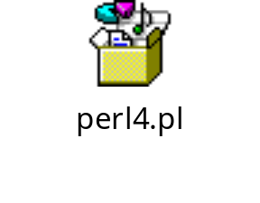
Exercise: 4
Use the file emp.lst.
Find the no. of employees in each department and also find the total salary in each department.

Slide 65
HASH
Assigning a hash value to an array variable:
A hash variable can be created as shown below:
%alpha = (a => 1, b=>2, c=>3, d=>4, e=>5, f=>6);
# if the value is not given, undef is assigned
# i.e. b=> , is equivalent to b=>undef,
@res = %alpha;
print "@res";
This piece of code produces the output: a 1 b 2 c 3 d 4 e 5 f 6
(i.e.) $res[0] = a;
$res[1] = 1;
$res[2] = b;
$res[3] = 2;
All even indices point to keys and all odd indices point to values.

Slide 66
HASH
Converting array to a hash variable
@arr = (a,1,b,2,c,3,a,4);
%hash = @arr;
print "%hash\n";
# a is overwritten with the recent value 4
How to delete an element from hash variable?
Use delete operator: delete $HASH{KEY}
delete $hash{a};
# The key "a" and its value gets deleted
print "%hash\n";

Slide 67
HASH
How to swap keys with values
%alpha = (a=>1, b=>2, c=>3, d=>4);
print "Original hash: ";
print %alpha;
%alpha = reverse %alpha;
print "\nThe hash after reverse: ";
print %alpha;
To print all the keys of a hash variable
print "\nAll the keys: ";
print keys(%alpha);
To print all the values of a hash variable
print "\nAll the values: ";
print values(%alpha);

Slide 68
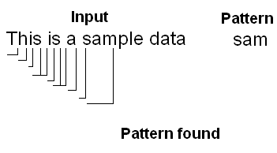
Pattern Matching
PERL is powerful in Pattern Matching with regular expressions.
Regular expression = Normal characters + Meta characters

Slide 69
Pattern Matching
Meta character | Significance
. | Any character except newline character
* | Zero or more occurrence of previous character or character set
? | Zero or one occurrence of previous character or character set
+ | One or more occurrence of previous character or character set
[ ] | Range of values
[^ ] | Not in the range
^pattern | Lines starting with "pattern"
pattern$ | Lines ending with "pattern"
{m, n} | Repetitive operator

Slide 70
Pattern Matching
Example1:
"a..a" - Having "a" followed by any 2 characters and followed by "a".
sample → Not match
sampath → Match
Aruna → Not match
a apple → Not match

Slide 71
Pattern Matching
Example2:
"a*" - May or may not have "a"
aruna → Match
china → Match
sheet → Match

Slide 72
Pattern Matching
Example3:
"a.*a" - Here, * means any no. of “.” s (i.e.) any no. of characters.
- Having "a" followed by any no. of characters followed
by "a".
aruna → Match
china → Not match
a apple → Match
maaaaya → Match
sampledata → Match

Slide 73
Pattern Matching
Example4:
"a?" - Having "a" followed by (may or may not) any character
a → Match
aaa → Match
bbb → Not match
abbba → Match

Slide 74
Pattern Matching
Explain the patterns:
"a+" →
"[abys]" →
"[a-z]" →
"[A-Z]" →
"[0-9]" →
"[a-z]..[A-Z][0-9]" →
Having "a" followed by any no. of "a"s
a or b or y or s
Any lower case letter
Any upper case letter
Any digit
Having any lower case character followed by any 2 characters followed by any upper case character followed by a digit.

Slide 75

Exercise: 5
User input is a mail id. Write a regular expression to validate the input.
“^[a-zA-Z0-9_]+[@][a-zA-Z0-9_]+[.][a-z]+$”
If the range indicator ([ ]) has only one character, it means the input must match with that character.

Slide 76
Pattern Matching
Some more patterns:
"[^a-z]" → Other than lower case letter
"[^A-Z]" → Other than upper case letter
"[^0-9]" → Other than digit
"^a" → Lines starting with "a"
"a$" → Lines ending with "a"
"^a.*a$" → Lines starting and ending with "a"
a{1,5} → "a" followed by 1 to 5 "a"s
a{1, } → "a" followed by 1 or more

Slide 77

Exercise: 6
Write a Perl program to display all lines from the file "emp.lst" which contain the word "sales".
The regular expression is denoted by /regex/.
This piece of code checks for the pattern "sales" anywhere in the line. If you want to check the pattern "sales" only in the 3rd column:
  while(<>){
  @res = split;
  if ( $res[2] =~ /sales/ ){
  print $_;
  }
  }

Slide 78
Exercise: 7
A file contains a lot of web addresses, write a Perl program to display only the valid web addresses.
  while(<>){
  if (/www[.][a-zA-Z0-9_].*[.][a-z].*/){
  print "$_";
  }
  }

Slide 79
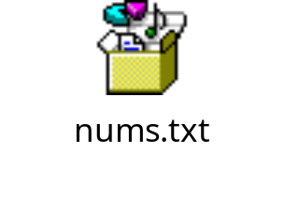

Exercise: 8
Create a file nums.txt by executing the following command in the command prompt: "seq 1 100 > nums.txt“.
Write a Perl program to replace all the odd numbers in the file nums.txt with blanks lines.

Slide 80
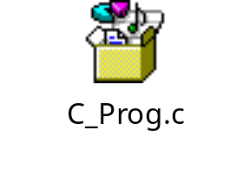
Exercise: 9
Write a Perl program to ignore commented lines from a file containing C program.
while (<>) {
unless ( /^ *[\/][*].*[*][\/]/ ){
print "$_";
}
}

Slide 81
Replace and Translate operators
Syntax for the search and replace operator: s/SEARCH/REPLACE/g
Example:
s/sample/Sam/g
Replace all the words containing the pattern "sample" to "Sam" in the given line.
Syntax for the translate operator:
tr/FORM1/FORM2/
Example:
tr/[a-z]/[A-Z];
Translate all the lower case letters to upper case letters in the given line.

Slide 82

Exercise: 10
Create a file nums.txt by executing the following command in the command prompt: “seq 1 100 > nums.txt”.
Write a Perl program to replace all the odd numbers in the file nums.txt with blanks.

Slide 83


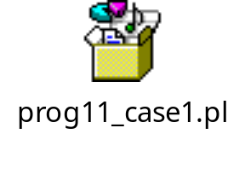
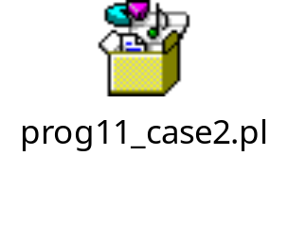
Exercise: 11
Prepare a file prints.txt as attached below:
Write a program to replace all "print" with "echo".

Slide 84
Perl specific shortcuts for character class
Character class |  | Perl Shortcut
Any digit | [0-9] | \d
Any word character | [a-zA-Z0-9_] | \w
Any whitespace | [\f\t\n\r ] | \s
Any non-digit | [^0-9] | \D
Any non-word character | [^a-zA-Z0-9_] | \W
Any non-whitespace character | [^\f\t\n\r ] | \S

Slide 85
Perl specific shortcuts for character class
Example
if (/^[0-9][a-zA-Z0-9_].* $/)
{
}
Indicates: Lines starting with a digit character, followed by a word character, followed by any "old chunk" (.* matches any character, any number of times) and ending with a space.
This can be written by using Perl shortcuts as below:
if ( /^\d\w.*\s$/ )
{
}

Slide 86

Exercise: 12
Write a Perl program to ignore commented lines from a file containing C program. Prepare the C program with the below contents:
Solution:
Improve the previous program to ignore the blank lines also.

Slide 87

Exercise: 13
Write a Perl program to count the number of executable lines in a C++ program

Slide 88
Pattern Memory
Whenever we place a pattern within a parentheses, the patterns are automatically memorized. It doesn’t remember the pattern itself but it remembers the part of the string which matches with the pattern.
These memory patterns are stored in the variables: \1, \2, \3...\512.
But these variables (\1, \2, \3, .. \512) can only be accessed in the same line where the patterns are memorized. (i.e.) Say, we need to print all the lines which have the same word in the start and end of the line.
if ( /^(\w+)\s.*\1$/ ){ print $_; }

Slide 89
Pattern Memory
In case if you want to access the memorized patterns even after the line where the patterns are memorized, use $1, $2, $3, ... $512 to access the Read Only variables \1, \2, \3, ... \512.
Say, we need to extract two consecutive numbers from a line
($first, $second) = /(\d+)\s(\d+)/ OR
if ( /(\d+)\s(\d+)/ )
{
$first = $1;
$second = $2;
}

Slide 90

Exercise: 14
Prepare a file "word2.txt“ as below:
Write a Perl program to print the lines which start and end with the same word and also the second and the last but one words must be same.
if ( /^(\w+)\s(\w+).*\2\1$/ )
{
print $_;
}

Slide 91
Pattern Memory
Important pattern memory variables in Perl:
$` → has the pattern before the match
$& → the match
$' → after the match
Write a Perl program which prints all the lines which has a number. Print the character "<" before the match and print ">" after the match.
  while (<>)
  {
  if ( /\d+/ )
  {
  print "$`<$&>$'";
  }
  }

Slide 92
Metacharacter Precedence
Level 1: () - Pattern memory
Level 2: ?, +, *, {m, n} - Multiplies
Level 3: ^, $ - Anchoring tags
Level 4: | - Alteration
Example for Alteration operator:
s/sales|purch//g; - Replace the words "sales" or "purch" with blanks.

Slide 93
References
Another name for the actual variable
Reference to a scalar
  $num = 10;
  $i_ref = \$num;
  print "$i_ref\n"; # Address will be printed
  print "$$i_ref\n"; # Indirect access of the num variable
  print "$num\n"; # Direct access of the num variable
Reference to an array
  @arr = (1,2,3,4,5..10);
  $ref = \@arr;
  print "$ref\n"; # Address of the array
  print "$$ref[0]\n"; # Accessing first element of the array
  print "@$ref\n"; # Accessing entire array

Slide 94
References
Reference to a hash
%emps = (arun=>1, basu=>2, chet=>3, dine=>4);
$ref = \%emps;
print "$ref\n"; # Address of the hash variable
print "$$ref{arun}\n"; # Value of the key "arun"
print %$ref; # Entire hash

Slide 95
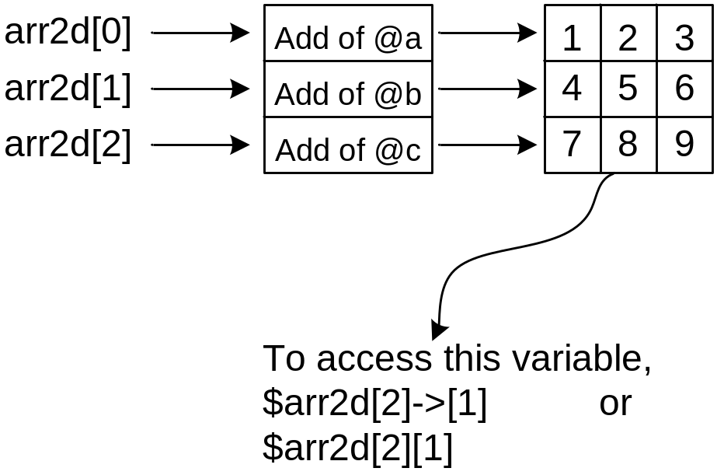
References
How do you build 2D array in Perl:
@a = (1,2,3);
@b = (4,5,6);
@c = (7,8,9);
@arr2d = (\@a, \@b, \@c);

Slide 96
Subroutines
How to define a subroutine:
  sub greet
  {
  print "hello\n";
  }
"sub" is the keyword which tells Perl that the following block is a subroutine.
How to call a subroutine:
If you are sure that there are no built-in function with the name same as the user defined function,
greet;
If there is a built-in function with the same as the user defined function, &greet;

Slide 97
Subroutines
How to pass arguments to a function:
  &greet("Basu");
The default Perl variable inside the function is an array: @_. (i.e.) all the arguments which will be passed to a function will be accessed through the array variable @_.
Example 1:
  sub greet {
  print "Hello $_[0]"; # accessing the first element in @_
  }
  greet("basu");

Slide 98
Subroutines
Example 2: (Method 1)
# Program to add two numbers and print the sum value
sub sum
{
($a, $b) = (shift, shift);
$res = $a + $b;
print "Sum is $res\n";
}
sum(10, 20);
sum(2.5, 30);
Example 2: (Method 2)
# Program to add two numbers and print the sum value
sub sum
{
print "Sum is ", $_[0] + $_[1];
}
sum(10, 20);
sum(2.5, 30);
But the good practice is not to use the implicit (default) variables directly.

Slide 99
Subroutines
How to return values from the function:
sub sum
{
($a, $b) = (shift, shift);
$res = $a + $b;
return $res;
}
$ans = sum(10, 20);
print "The sum value: $ans\n";

Slide 100
Subroutines
Say, there is a requirement: a function should start its processing only if sufficient arguments are passed. For example, a function should start its further processing only if it receives 2 arguments.
sub myfunc {
if ( @_ == 2 ) {
print "Arguments are fine\n";
}
else {
print "Invalid arguments\n";
exit
}
}
myfunc(10,20);
myfunc("Hello", 20);
myfunc(10);
myfunc(1,2,3,4);

Slide 101
Subroutines
Function prototyping:
  sub hello($$) #function with two mandatory arguments
  {
  print "The function has received: @_";
  }
  hello; # syntax error: not enough arguments
  hello 10, 20;

Slide 102
Subroutines
How do you pass two array variables to a Perl function? When we pass two array variables as arguments to a function, both array variables will be assigned to the default implicit array variable @_. You will not be able to identify the individual array variables.
Solution: Pass array arguments as references. func(\@a, \@b);
Example:
sub func
{
@arr1 = @{$_[0]};
@arr2 = @{$_[1]};
print "The two arrays are:
@arr1 and @arr2\n";
}
@a = (1, 2, 3);
@b = (4, 5, 6, 7, 8, 9);
func(\@a, \@b);

Slide 103

Exercise: 15
Write a Perl program to find sum of “n” numbers.

Slide 104

Perl’s array are greedy!
Consider the Perl program:
Output:
  Array: 10 20 30 40 50
  Variable1:
  Variable2:
The entire list has been assigned to the first array in the function.
How do you write a Perl subroutine which can differentiate an array and the scalar variables?

Slide 105


Perl’s array are greedy!
Solution 1: Have array as last argument
Solution 2: Use reference

Slide 106

Subroutines
The below program shall explain how to pass a hash variable to a Perl subroutine.
If you want to handle scalar and hash variables in a subroutine, extract hash as a last argument
If you want to work with multiple hashes, use references.

Slide 107
Command line arguments in Perl
All the command line arguments are stored under an array @ARGV.
Example:
  #!C:\Perl\bin\perl
  print "@ARGV\n";
If the above piece of code is stored in a file "cmdline.pl“,
perl cmdline.pl arg1 arg2 arg3 arg4 arg5 arg6
The output: arg1 arg2 arg3 arg4 arg5 arg6

Slide 108
Command line arguments in Perl
Say, we need to write a Perl program which should start processing only if it receives 2 arguments through command line.
  #!C:\Perl\bin\perl
  unless (@ARGV == 2)
  {
  print "Insufficient Args\n";
  print "Usage: perl $0 arg1 arg2\n";
  exit;
  }
  print "Fine\n";

Slide 109
Variable Scoping
sub func
{
$str = "I am in sub";
print "$str\n";
}
$str = "I am in main";
print "$str\n";
func;
print "$str\n";
Output:
  I am in main
  I am in sub
  I am in main
All variables are global (by default) in Perl.

Slide 110
Variable Scoping
All the local variables should be prefixed with "my".
sub func
{
my $str = "I am in sub";
print "$str\n";
}
$str = "I am in main";
print "$str\n";
func;
print "$str\n";
All the global variables should be prefixed with "our".
sub func
{
my $str = "I am in sub";
print "$str\n";
}
our $str = "I am in main";
print "$str\n";
func;
print "$str\n";

Slide 111
Variable Scoping
There cannot be global variables within sub-routines.
It is a good practice to use the keywords "my" / "our" when declaring variables.
The "strict" pragma (module) is recommended in every Perl program which traces any misspelled variables. The "strict" pragma mandates to use "my" / "our" in every Perl program.
Example:
  #!C:\Perl\bin\perl
  use strict;
  my $myvar = 45.789;
  print "My variable: $myvar\n";
Programs run faster when we use "use strict";

Slide 112
Files and Directories
How to open a file?
open(FILEHANDLE, filename);
Example:
open(FH, ">sam.txt"); # open the file in write mode
open(FH, "sam.txt"); # open the file in read mode
open(FH, "<sam.txt"); # open the file in read mode
open(FH, ">>sam.txt"); # open the file in append mode
open(FH, ">+sam.txt"); # open the file in append mode
How to close a file?
close FILEHANDLE;
Example:
close FH;

Slide 113
Files and Directories
How to read from a file?
open(READ, "emp.lst");
while(<READ>)
{
print "$_";
}
close READ;
How to write into a file?
open(WR, ">imp.txt");
print WR "Hello\n";
print STDOUT "Hello\n";
print WR "bye\n";
close WR;

Slide 114

Exercise: 16
Implement "cp <srcfile> <destfile>" command in Perl.

Slide 115
Files and Directories
Directory handling:
#!/usr/bin/perl
# My "ls" program
opendir(DIR, $ARGV[0]);
foreach (readdir(DIR))
{
print "$_\n";
}
closedir DIR;

Slide 116
Files and Directories
File Test Operator | Meaning
-f | Returns true if the specified file is a regular file
-d | Returns true if the specified file is a directory
-r | Returns true if read permission exists in the specified file
-w | Returns true if write permission exists in the specified file
-x | Returns true if execute permission exists in the specified file
-s | Returns true if the specified file size is non-zero
-z | Returns true if the specified file size is zero

Slide 117

Exercise: 17
Write a Perl program which prints the no. of files and directories present in the specified directory.

Slide 118
Some more exercises
Write a Perl subroutine which finds the square value of a number. Print error message if the input is not a number.

Slide 119


Slide 120


